Slide 1



An Easy to Use
End to End Platform for
Simple Corporate Meetings

Slide 2
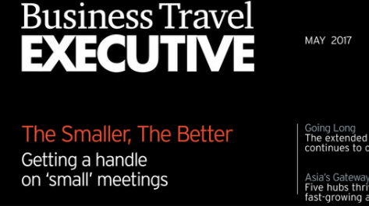
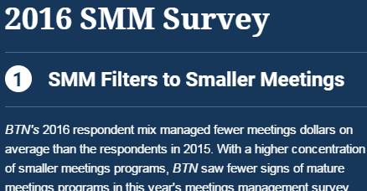
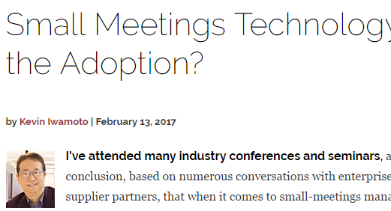

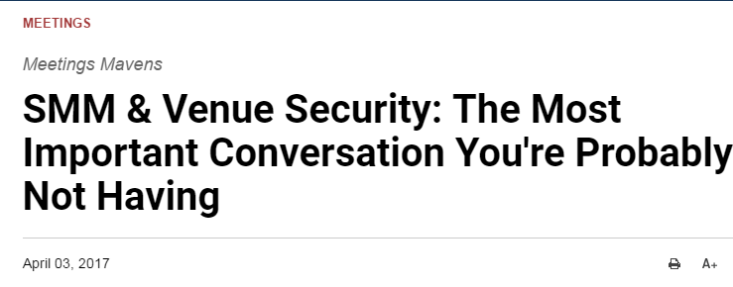
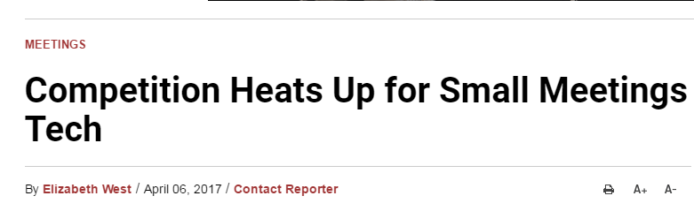
Everyone’s talking about Small & Simple Meetings – Are you?
Notes:
Travel Leaders is at the forefront of the innovation; you may remember last years session when the topic was not in the headlines but Travel Leaders raised your awarness

Slide 3

Here is an interesting statistic.
Why do you think it is happening?
80% of meeting are coordinated by employees outside of company travel departments with unmanaged costs and non compliance for preferred suppliers.
Notes:
Maybe the question should be why can you continue to let it happen? Let’s discuss some common misconceptions about simple meetings before we talk about why you cant risk ignoring them any longer.

Slide 4
Do you think your organization doesn’t have simple meetings?
*compiled by AMEX Meeting and Events Study from 2016.
Notes:
From this breakdown, we can see that only 10% of meetings are likely always large - Conference and Product Launch. All other categories are typically small and simple. They are likely happening in your organization, but because the process is decentralized and rogue, you likely aren’t aware of the volume of simple meeitngs.

Slide 5
Does size really matter?
Notes:
When we talk about small or simple meetings they are considered to be those meeting that are under 250 people, common agenda, registration flow, single room block. That would be 60-70 % of al types of meeting. However, a Board of Directors meeting for 5 people may be the highest touch event you do all year.

Slide 6
Who has time for spreadsheet hell?
(Or phone calls, faxes or mistakes)
Notes:
I am want to pause of a moment and look at the categories below – Simple meetings have less lead time and the planner within the company likely already has a full time job; do you think that your staff would benefit from automation or by utilizing your agency for this category of travel? Raise your hand if you think it is possible. Have you seen the face of that college graduate when you asked them to fax a hotel? They have no idea what you are talking about.

Slide 7

The “Gap” between Transient and Meetings
Simple Meetings
Transient
60%-80% of Company’s Meetings
Internal Meetings & Non-Complex
No Visibility & Decentralized
Rogue Bookings
Large Meetings
Hotel Program
Negotiated Rates
Large Meetings
Event Management
COMPLEX EVENT TECHNOLOGY
INDIVIDUAL TRAVEL
Notes:
For every reason your company invests in Concur and complex event technology, you should invest in simple meetings. Consider it as an extension to your Concur investment.

Slide 8

What is a Simple Meeting?
Combination of Sleeping Rooms, Meeting Space, F&B, Audio Visual & Air
with the same registration flow & common agenda
for 4 to 1,000 attendees
Simple Meetings
Internal Meetings
Sales Meetings
Speaker Series
Breakfast Events
Trainings
Store Openings
Recruiting
Project Teams
Complex Meetings
Large Marketing Events
City Wide Conventions
Trade Shows
High Visibility Board Meetings
Notes:
We did a meeting 2 weeks ago. Corporation signed the contract on Monday, they were connected to Concur on Tuesday and by Thursday, they had created a reg site and 1,000 people registered.

Slide 9
Simple Meetings is the Last Piece of the Puzzle
for a managed corporate travel program
Duty of Care
Risk Mitigation
Savings
Engagement
Data
Duty of Care
Risk Mitigation
Savings
Engagement
Data
Know where your attendees are at all time
Integrates to GDS & Concur
Visibility into all Meetings
Portal with policies
Approvals
Centralized contract signatures
Minimize attrition clauses
Hotel addendum
Visibility into rogue bookings
Savings of 5-25%
Get 3-5 Bids
Maximize negotiated rate programs for transient and meetings
Enforce preferred hotels
Save time and money
Easy to use
B2C feel & fun tools
Better Meetings experience End to End solutions
Company wide visibility into 100% of Meetings
Savings reports
Spend reports
Logistic reports
Meetings Intelligence
Notes:
Does your company know where you are staying tonight? Not if you booked from the room block.
Every day you wait to address this large category of spend, you are exposing the company to unnecessary risk, wasting the organizations’ money and advocating for inefficient processes. Now that technology is available and affordable, which of these are OK with you?

Slide 10

Who Owns This Category of Spend?
Decentralized & Hybrid Models
Travel Arrangers
& Occasional Planners
Travel Managers
Director of Meetings
Agencies

Slide 11

It’s Your Hotel Program
Curated out of 298,000 Hotels worldwide
Preferred Hotels & Negotiated Transient Rates
Simple Meetings Hotel Addendum
Corporation or TMC Chain Contacts
GROUPIZE I 10

Slide 12

Easy to Use &
End to End Platform
Simple Pricing
Rules & Portals
1-9 Room Booking Engine
Meeting Sourcing
Registration
Room Block Management
Air Management
Event App
Budgets
From Starter
$299/Month
To Unlimited
$999/ Month
No Per Attendee Fee
No Per User Fee

Slide 13
Ease of Use + Modules + Integrations
to corporate travel systems is a key technology
Company Portal
1-9 Rooms
eBids
for
Meetings
Profiles
& Rules
Duty of Care
Hotels & Room Blocks
Registration Web Site & App
Data & Reports
Notes:
Then be ready for end to end

Slide 14

Typical Objections
You are not aware it is a problem because you have no visibility
No clear ownership - falls between the travel manager and meeting department
Administrators love the perks of planning a meeting
You have looked at technology but it was too difficult and too expensive
You are afraid of the costs
You don’t want to lose the control
Adoption of a new system
You are not aware that your agency can fix it
Next year
What could really go wrong?
Notes:
Who can relate to at least three of these objections? Let’s work our way up, who has had an admin show up in their office crying because they did not know what the word attrition meant? Who has had to explain to the CFO that they did not know that admins were signing contracts? Why is it that an admin likely cant buy a ream of paper without approval but they can sign a hotel contract?

Slide 15
https://projects.invisionapp.com/share/XTBRF4MR7#/screens
Demo
GRUPIZE I 12

Slide 16

Step 1: Start the dialogue with your agency
Do you have a Strategic Meetings Management Program?
Do you want access to the Travel Leaders Worldwide Hotel Program Rates?
Do you regularly have small groups of employees traveling together?
Who is currently handling your small meeting planning?
Is your company using a registration solution of any kind? Does it include travel or is it a marketing tool?
What is the biggest pain point with small meetings
Are you surprised by meeting spend on the T& E Card?
Do you call your agency in a panic for air manifests?
Do admins call you to help them out of attrition penalties?
Could you get more from your preferred hotels if they knew you were sending them both transient and meetings?
Are you losing on hotel spend or concessions?
Notes:
The reality is that your company is being exposed to unnecessary risk if you are not including Simple Meetings in your SMM. Clauses like Mutual Indemnification, Limited Liability, Insurance Minimums, Cancellation Clauses, Attrition Clauses are all common elements that a professional meeting planner would insist on. However, the occasional planner likely is not as well informed. One canceled meeting can cost thousands of wasted dollars. One small accident on the property can even expose your company to unnecessary litigation. Start the dialogue. You are not alone. Until now technology was not available to help you conquer this problem.

Slide 17
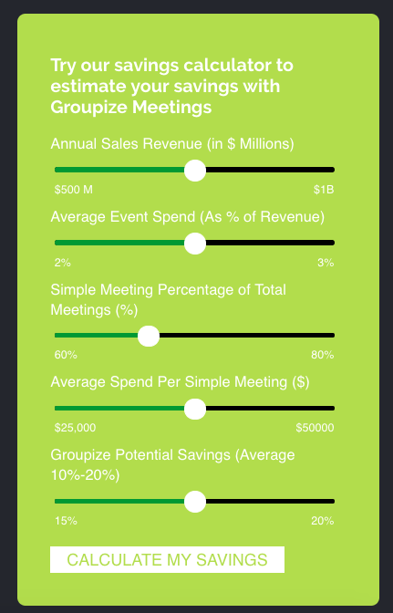
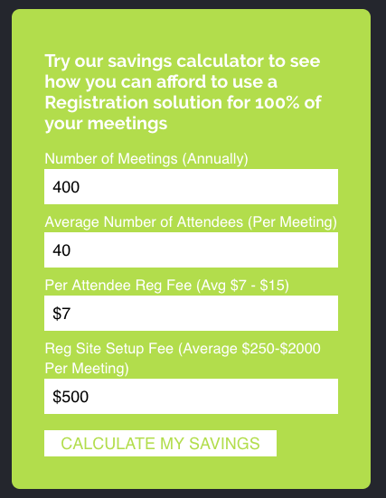
Why Now? Guaranteed ROI
Sourcing Calculator
Registration
GROUPIZE I 13

Slide 18
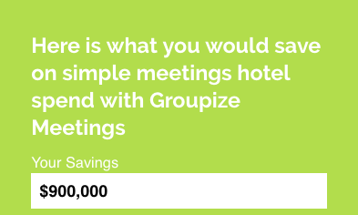
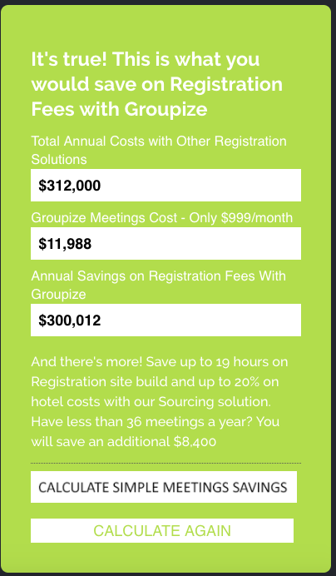

Major Savings &
Risk Mitigation Opportunity
Sourcing Savings
Registration Savings
Duty of Care
Risk Mitigation
Engagement
Data

Slide 19
Why Now? Guaranteed ROI
Sourcing Calculator
Registration

Slide 20


You “Can’t Afford” To Wait
Measure
Start
Easy to Use
Easy to Implement
Mobile App
Source
$299-$999 /Month
Book Travel
Guaranteed ROI
Manage

Slide 21

Q & A

